Slide 1
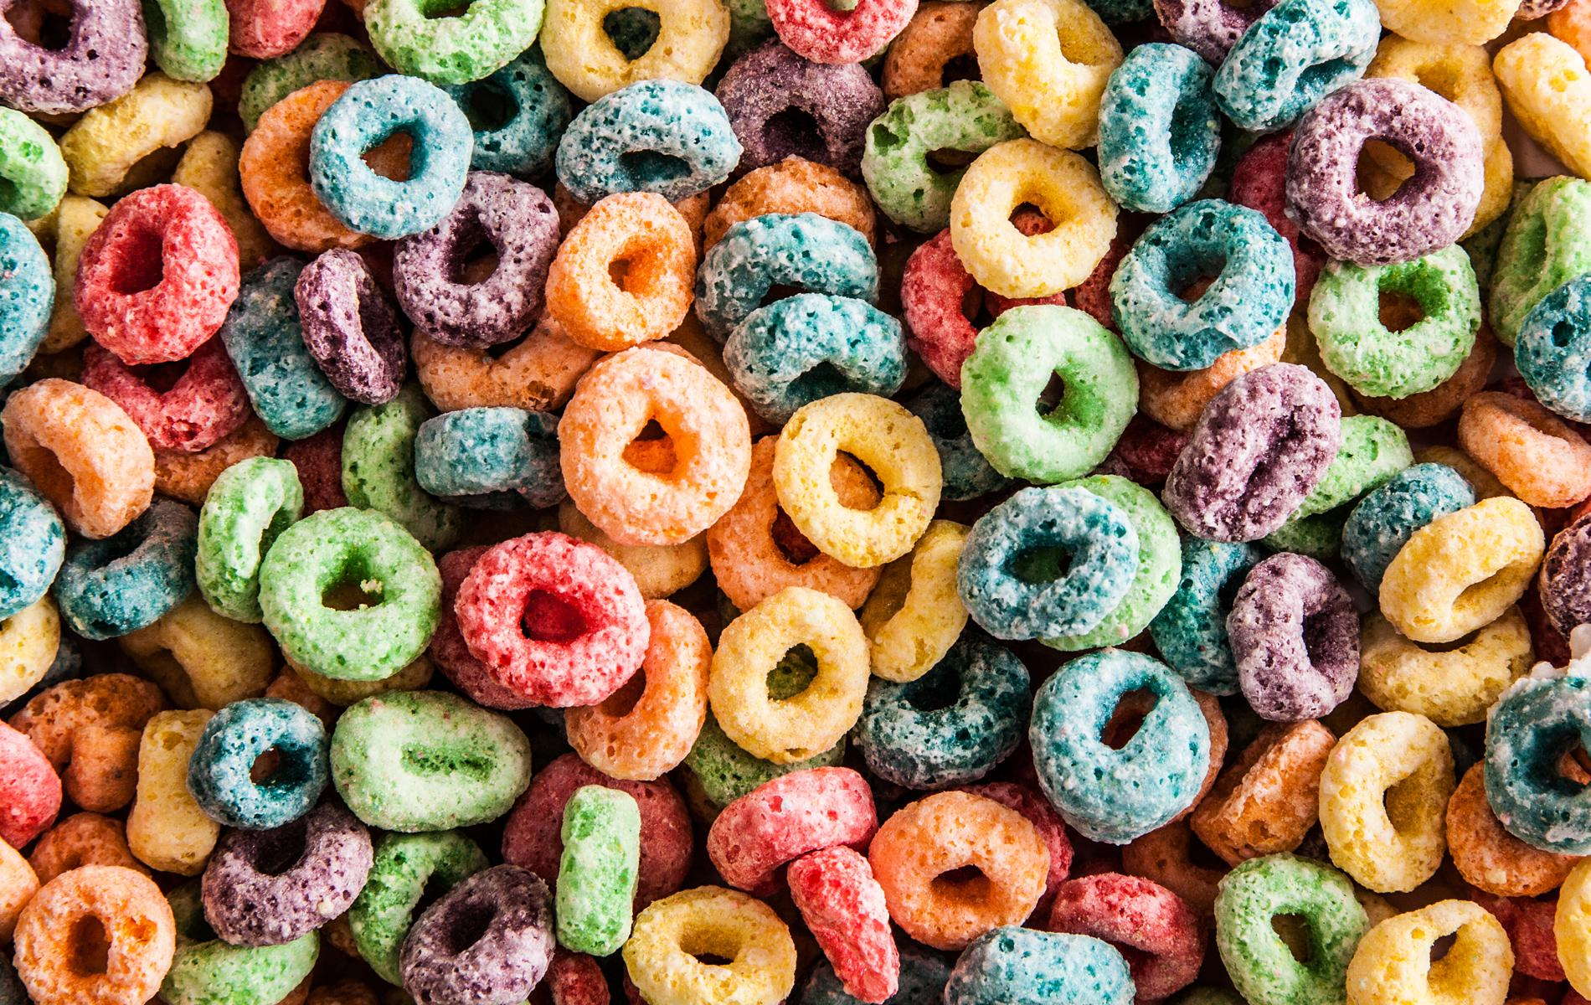
Python Loops

Slide 2
Objectives
For loops review
Intro to while loops
Continue, as long as…
How to fix infinite loops
How to stop loops
Break statement
Use a flag
conditional check
Favorite Game program
Making a function call in a while loop
Adding to a list
Using a break statement/letting the user choose when to quit
Removing all repeats in a list using a loop and remove() function

Slide 3
Remember for loops?
1 for i in range(4):
2 print(“Hello World!”)
Run it, to get….
Hello World!
Hello World!
Hello World!
Hello World!

Slide 4
For loop
Takes a collection of items and executes a block of code once or however many times you tell it to

Slide 5

While Loops

Slide 6
While Loops
The while loop runs as long as (or while) a certain condition is true
For example,
Consider a program that adds to a starting number, as long as the number being added to it is less than or equal to a certain number.

Slide 7
Start with a number...
1
We want to start counting from this number
1 + 1 = 2
Count from the next number, by one
2 + 1 = 3
Keep counting.. Until, the number 5 is reached
4 + 1 = 5

Slide 8
Make a new file
called counting.py

Slide 9
Pseudocode
Python code
Make our starting number equal the number 1
As long as that number is less than or equal to 5,
Keep adding 1 to that number
current_number = 1
while current_number <= 5:
print(current_number)
current_number += 1

Slide 10
What is Happening
current_number = 1
while current_number <= 5:
print(current_number)
current_number += 1
Python runs the loop as long as the condition ccurrent_number<= 5 is true.
Because 1 is less than 5, Python prints 1 and then adds 1,
making the current number 2, and so on.
The += operator is shorthand for current_number = current_number + 1

Slide 11
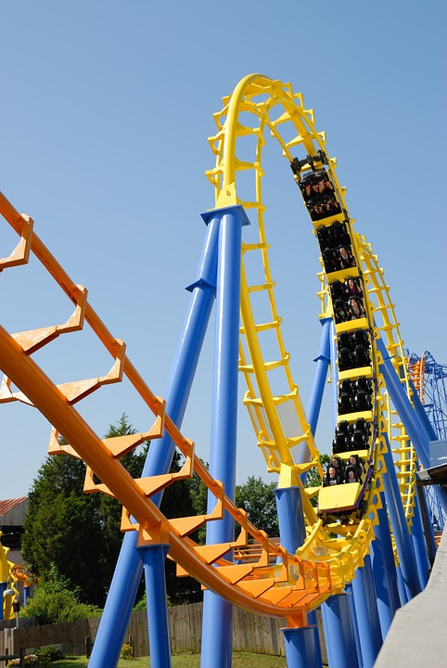
Using continue in a loop

Slide 12
Make a new file called
counting_continue.py

Slide 13
“Continue” in a loop
Instead of breaking out of a loop without executing the rest of the code,
Use a continue statement to return to the beginning of the loop based on the result of a simple conditional test.
current_number = 0
while current_number <= 10:
current_number += 1
if current_number % 2 == 0:
continue
print(current_number)

Slide 14
Avoid Infinite Loops!

Slide 15
Make a new file called
infinite.py

Slide 16
infinite.py
Every while loop needs a way to stop running, so it won’t continue to run forever
For example, make another counting loop that should count from 1 to 5:
x = 1
while x <= 5:
print(x)
#x += 1

Slide 17
How to stop loops!
Control Statements and techniques to exit a loop:
Break
Use a flag
Quick check
Pass
Continue
So we know how to make a program with a while loop… how can stop a loop?!

Slide 18

Letting a user choose when to quit

Slide 19
Make a new file called
game_break.py

Slide 20
We’ll be able to...
Use our function in a loop
Add the user’s input to a list
Use the break statement to exit the loop

Slide 21
game_break.py
Let’s make a program keep asking for the user’s favorite game and add it to a list as long as the user wants.
prompt = "\nTell me your favorite game and I'll add it to the list."
prompt += "\nEnter 'quit' to end the program"
prompt += "\nEnter game here: "
games = []
def all_games():
print("\nHere is a list of the games so far: ")
print(games)

Slide 22
prompt = "\nTell me your favorite game and I'll add it to the list."
prompt += "\nEnter 'quit' to end the program"
prompt += "\nEnter game here: "
games = []
Defining our function
def all_games():
print("\nHere is a list of the games so far: ")
print(games)
Starting our loop
while True:
new_game = raw_input(prompt)

Slide 23
Defining our function
def all_games():
print("\nHere is a list of the games so far: ")
print(games)
Starting our loop
while True:
new_game = raw_input(prompt)
Setting up our condition statements
if new_game == 'quit':
break
elif new_game != 'quit':
games.append(new_game)
all_games()

Slide 24

Remove all instances of a specific value in a list

Slide 25
Make a new file called remove_loop.py

Slide 26
remove_loop.py
We are familiar with how to remove an item from a list using the remove() function
What if we wanted to remove several of the same items all in one swoop?
TRANSECT EXAMPLE!
Let's say you had a list of different kinds of trees and the value 'red maple' repeated several times.
And let’s we wanted to remove every ‘red maple’ from the list

Slide 27
remove_loop.py
So we have a list of trees:
tree_types = ['yellow poplar', 'loblolly', 'red maple', 'black gum', 'red maple', 'loblolly']
print(tree_types)
Our goal is to remove every red maple from the list. Example:
tree_types.remove('red maple')
print(tree_types)
But, we’d have to do this more than once
So it makes sense to use a loop that removes all the items we want

Slide 28
The loop
while 'red maple' in tree_types:
tree_types.remove('red maple')
print(tree_types)
# Python deletes one instance of the value, then runs through the loop again to delete other instances

Slide 29
Last week:
Told Python to return to the beginning of a loop with continue
Avoided infinite loops
Learned and used ways to Exit a loop
Break
Condition Test

Slide 30

Using a flag to exit a loop

Slide 31

AND fill a dictionary

Slide 32
Make a new file called fill_a_dictionary.py

Slide 33
We’ll learn how to...
Use a flag to exit a loop
Check to see if a variable is true or false
If TRUE, stay in the loop
If FALSE, exit the loop
Fill a dictionary with a loop

Slide 34
fill_a_dictionary.py
In this example, the user's will be asked for their name and a stream or river they visited
First set up an empty dictionary
responses = {}
Set a flag to indicate that polling is active
polling_active = True

Slide 35
responses = {}
polling_active = True
As long as the above flag is True, Python will run the while loop code
while polling_active:
name = raw_input("\nWhat is your name? ")
response = raw_input("Which VA stream did you take measurements? ")
storing the responses
responses[name] = response
repeat = raw_input("Is there another person on your team to respond? (yes/no) ")

Slide 36
Is the flag still True?
repeat = raw_input("Is there another person on your team to respond? (yes/no)")
if repeat == "no":
polling_active = False
Polling is complete.
Now, Show the results by looping through dictionary
print("\n--- Stream Visitation Results ---")
for name, response in responses.items():
print(name + " took measurements at the " + response + " site.")

Slide 37
Sources
Websites
http://introtopython.org/while_input.html#Exercises-while
Books
Matthes, Eric. "Dictionaries." Python Crash Course: A Hands-on, Project-based Introduction to Programming. San Francisco: No Starch, 2016. 100-12. Print.
Briggs, Jason R. Python for Kids: A Playful Introduction to Programming. San Francisco, CA: No Starch, 2013. Print.

Slide 38
Speaking of programming real-world situations...

Slide 39
Object-Oriented Programming

